Slide 1
CASE STUDY 2 monitoring and controlling top secret
by:
LIKITHA.S
BHAGYASHREE.V
BI BI AYESHA

Slide 2
TOP SECRET
“Prisons are easier to enter than Visa’s top secrete Operations Center East (OCE). It is the biggest, newest and most advanced U.S data center”.
Every day, Visa processes same 150 million retail electronic payments from around the globe.
There are hundreds of security cameras and a superb security team of former military personnel.
Although hackers are a primary concern, There’s worries about network capacity too.
OCE is described as a “Tier-4” center, which is certification from a data center organization.

Slide 3
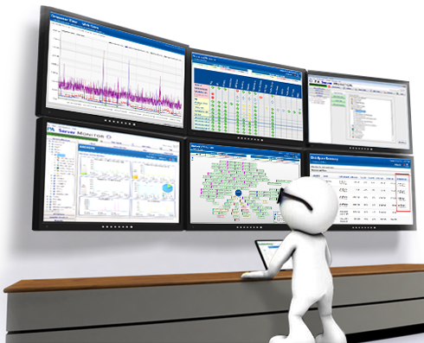

Monitoring the data:

Slide 4
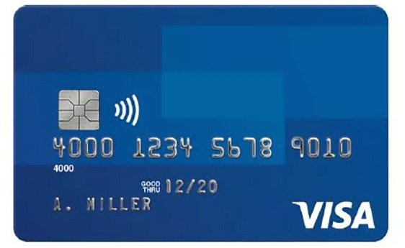
DISCUSSION
Is Visa being overly cautious? Why or Why not? Why is this level of controls necessary?
Visa is not being overly cautious.
Hackers have endless abilities to steal and sell valuable information.
Need to make sure the information is secure.
Thus Visa has the level of control that they do.

Slide 5

Hackers can easily hack any data:

Slide 6
HOW TO CONTROL ?
Why all the precautions ?
Hackers are increasing.
Data is being a black-market commodity.
Instantly respond to threats.
Which controls would be more important to visa : feed forward, concurrent or feedback ?
I think , ALL these are equally important.
But , concurrent controls would be very much important in helping visa.
Credit card companies are number one target for hackers.

Slide 7
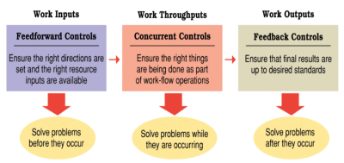

Controlling

Slide 8

Thank you!

